Slide 1

Proofs
Presented by:
Elizer Ponio Jr.
Department of Computer Science
College of Computing and Information Technologies

Slide 2
Outline
Introduction and Definition

Slide 3
Introduction to Proofs
Until this point in your education, mathematics has probably been presented as a primarily computational discipline.
You have learned to:
Solve equations
Compute derivatives and integrals
Multiply matrices and find determinants
And you have seen how these things can answer practical questions about the real world. In this setting your primary goal in using mathematics has been to compute answers.

Slide 4
Introduction to Proofs
But there is another side of mathematics that is more theoretical than computational
Here the primary goal is to:
Understand mathematical structures
Prove mathematical statements
Invent or discover new mathematical theorems and theories

Slide 5
Introduction to Proofs
The mathematical techniques and procedures that you have learned and used up until now are founded on this theoretical side of mathematics.
For example, in computing the area under a curve, you use the fundamental theorem of calculus. It is because this theorem is true that your answer is correct.
However, in learning calculus you were probably far more concerned with how that theorem could be applied than in understanding why it is true. But how do we know it is true?
How can we convince ourselves or others of its validity? Questions of this nature belong to the theoretical realm of mathematics.

Slide 6
Introduction to Proofs
You will learn and apply the methods of thought that mathematicians use to verify theorems, explore mathematical truth and create new mathematical theories.
This will prepare you for advanced mathematics courses, for you will be better able to understand proofs, write your own proofs and think critically and inquisitively about mathematics

Slide 7
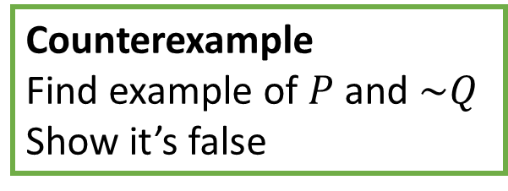
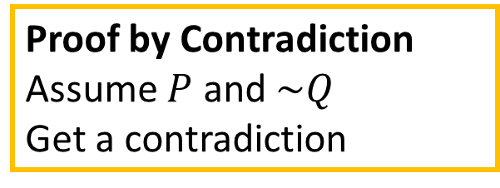
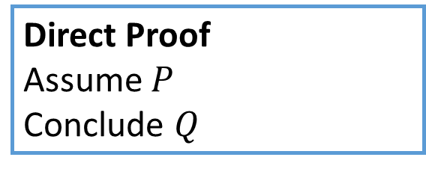
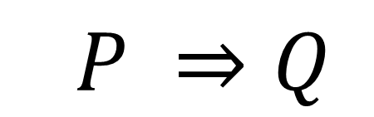
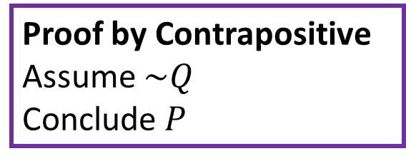
Proof Techniques
$$P ⇒Q$$
Direct Proof
Assume $P$
Conclude $Q$
Proof by Contradiction
Assume $P$ and $\sim Q$
Get a contradiction
Proof by Contrapositive
Assume $\sim Q$
Conclude$P$
Counterexample
Find example of $P$ and $\sim Q$
Show it’s false

Slide 8
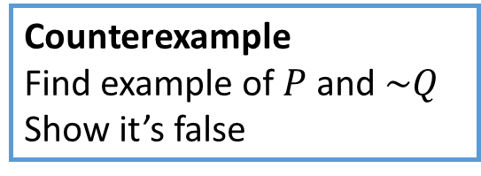
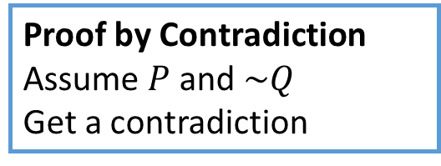
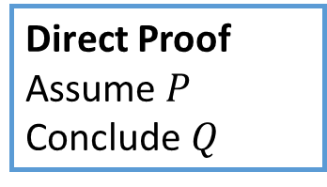
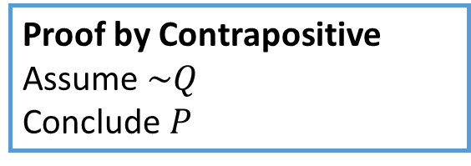
Proof Techniques
We will prove$P ⇒Q$ using the four approaches.
Direct Proof
Assume $P$
Conclude $Q$
Proof by Contrapositive
Assume $\sim Q$
Conclude$P$
Proof by Contradiction
Assume $P$ and $\sim Q$
Get a contradiction
Counterexample
Find example of $P$ and $\sim Q$
Show it’s false
In each case, we will prove the following statement:
The sum of any two consecutive numbers is odd.

Slide 9
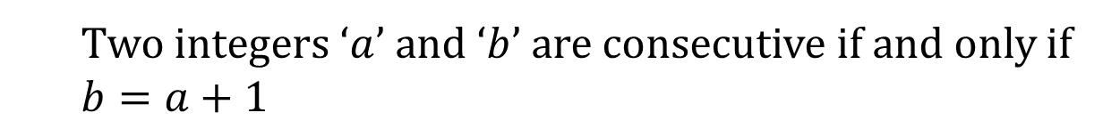
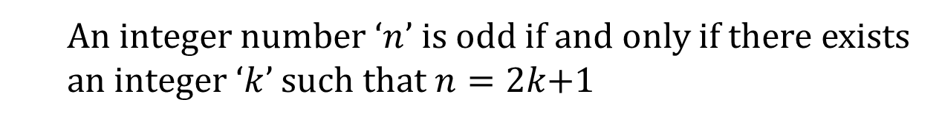
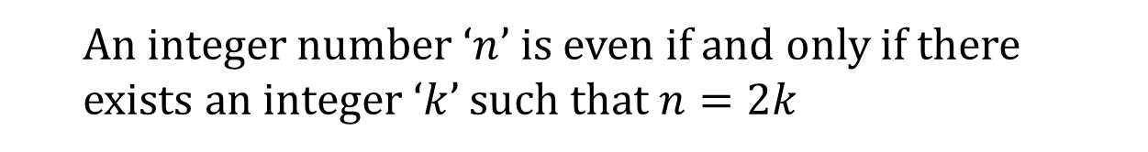
Definitions
Definition 1
An integer number ‘$n$’ is even if and only if there exists an integer ‘$k$’ such that $n=2k$
Definition 2
An integer number ‘$n$’ is odd if and only if there exists an integer ‘$k$’ such that $n=2k$+1
Definition 3
Two integers ‘$a$’ and ‘$b$’ are consecutive if and only if $b=a+1$

Slide 10
Introduction to Proofs
The sum of any two consecutive numbers is odd.
The statement above may not feel like a $P ⇒Q$ statement, but we can phrase it
If ‘a’ and ‘b’ are consecutive numbers
Then, the sum of ‘a’ and ‘b’ is odd.

Slide 11
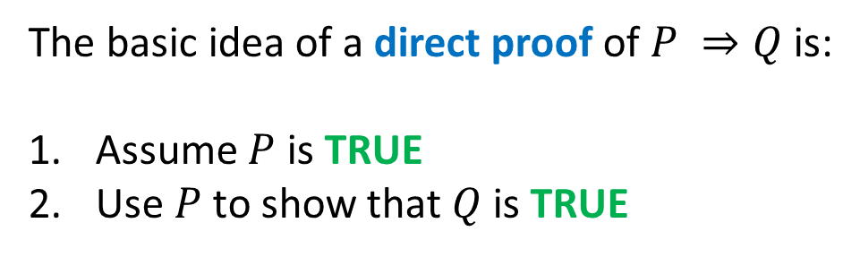
Direct Proofs
The basic idea of a direct proof of $P ⇒Q$ is:
Assume $P$ is TRUE
Use $P$ to show that $Q$ is TRUE

Slide 12
Direct Proofs
If ‘a’ and ‘b’ are consecutive numbers
Then, the sum of ‘a’ and ‘b’ is odd.
Assume a, b are consecutive
Know b = a + 1
So a + b = a + (a + 1) = 2a + 1
2k + 1 where k is an integer

Slide 13
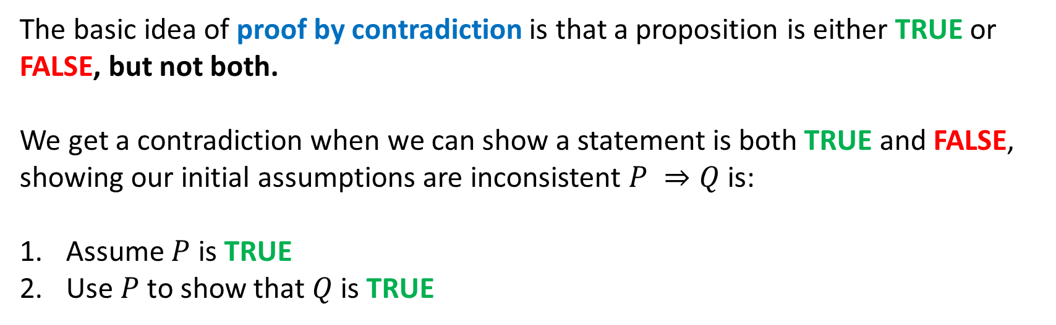
Proof by Contradiction
The basic idea of proof by contradiction is that a proposition is either TRUE or FALSE, but not both.
We get a contradiction when we can show a statement is both TRUE and FALSE, showing our initial assumptions are inconsistent $P ⇒Q$ is:
Assume $P$ is TRUE
Use $P$ to show that $Q$ is TRUE

